Slide 1
With Winning in Mind
By Lanny Bassham
Pages 1-29

Slide 2
It doesn’t matter if you win or lose – until you lose
All the kids who won the races were the happiest
  Lanny was not good enough to even be average
  He was frustrated that he struggled in all these sports
  Lanny’s father
    Nothing wrong with you son, you just haven’t found what you are good at yet
  Lanny en route to his Olympic medals became for confident and in control
  He was a different person

Slide 3
Winning is a Process
95% of all winning is accomplished by only five percent of the participants
  Pareto Principle
Many champions feel fortunate, but not gifted
  Talent = skill and it is acquired not awarded
What separates the winners from everybody else?
  The way they think
    Winners are convinced they will finish first
    Others hope they finish first

Slide 4
If it is not like you to win, you have NO CHANCE
Champions don’t TRY to win
  They try to have a good performance by doing these certain things
  Effort towards a process not an outcome
  “Glorify God and process is primary”
    Becoming outcome oriented leads to over-trying
Working hard in practice, working easy in competition
Many ways to win, not just by finishing first
  Advancing down the road to achievement

Slide 5
Set a goal to have a winning performance, instead of winning the competition
  But the player who performs the best wont always win the competition
Think about winning, and that time is while training for the event
  “like you” to win
Performance is 90% mental
  Yet most people only train this part of their game less than 10% of the time

Slide 6
If you can define it, you can duplicate it
  If you can duplicate it, you can achieve mental consistency
    If you can have mental consistency, you can win!

Slide 7
Mental Management
P. 18
The process of improving the probability of having a consistent mental performance, under pressure, on demand
3 Mental Components
  Concious Mind
  Subconcious Mind
  Self Image

Slide 8
Conscious Mind
Thoughts and mental pictures
Controls all your senses
Processes your environment
What kind of success do you desire??

Slide 9
Subconscious Mind
Source of the skills and power to perform
Developed through repetition of conscious thought
Once you can perform something subconsciously, you can make room to consciously practice new skills

Slide 10
Self Image
“acting like you”
Most important according to Lanny
Every time we think of something, it creates an imprint that is stored in the self image
  Self image generates a view on how you see yourself based on these imprints

Slide 11
Conscious mind sets Goals , examines environment
Subconscious mind performs the tasks that were practiced by the conscious mind
Self image controls the amount of subconscious skill you will use based on what is like you

Slide 12
Great Performances Flow
P. 23
The triad state
  Conscious, subconscious, and self image are all in balance
    Conscious – subconscious connection
    Self image – subconscious connection

Slide 13
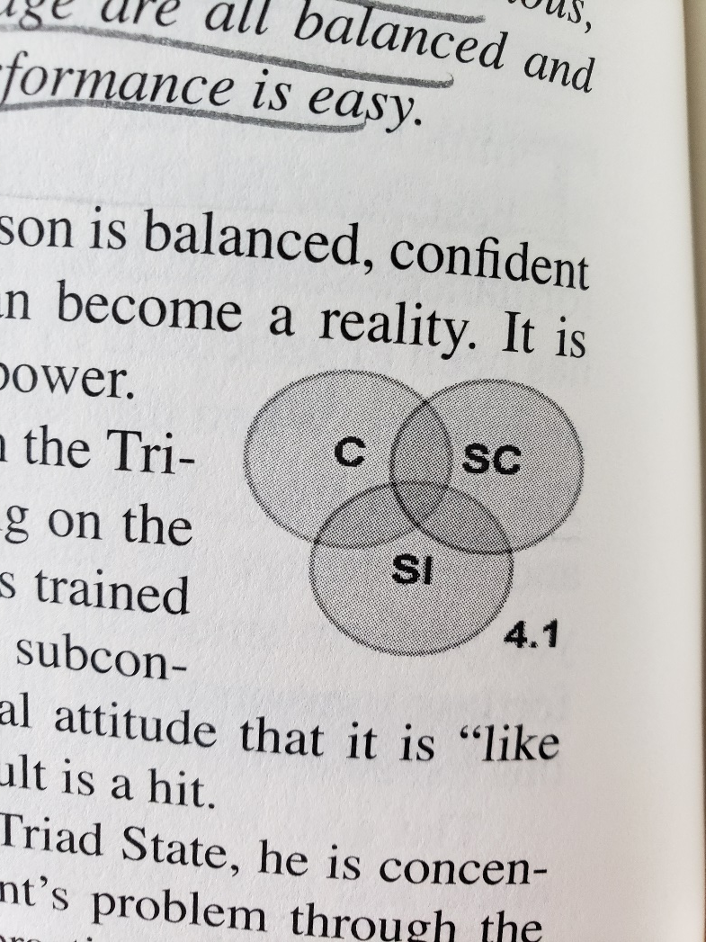
The Principle of Balance
Consciously focused on the process
Subconscious Performance
“it is like me to win”
  Effortless

Slide 14
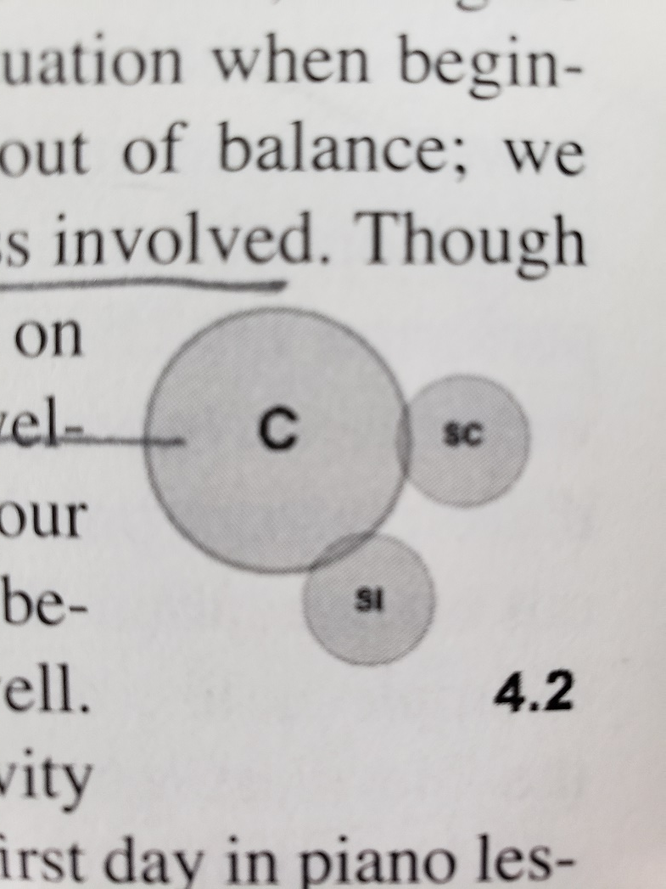
Too much Conscious involved
Happens when we begin a new activity
Subconscious skill has not yet developed
Self image tells us we are beginners

Slide 15
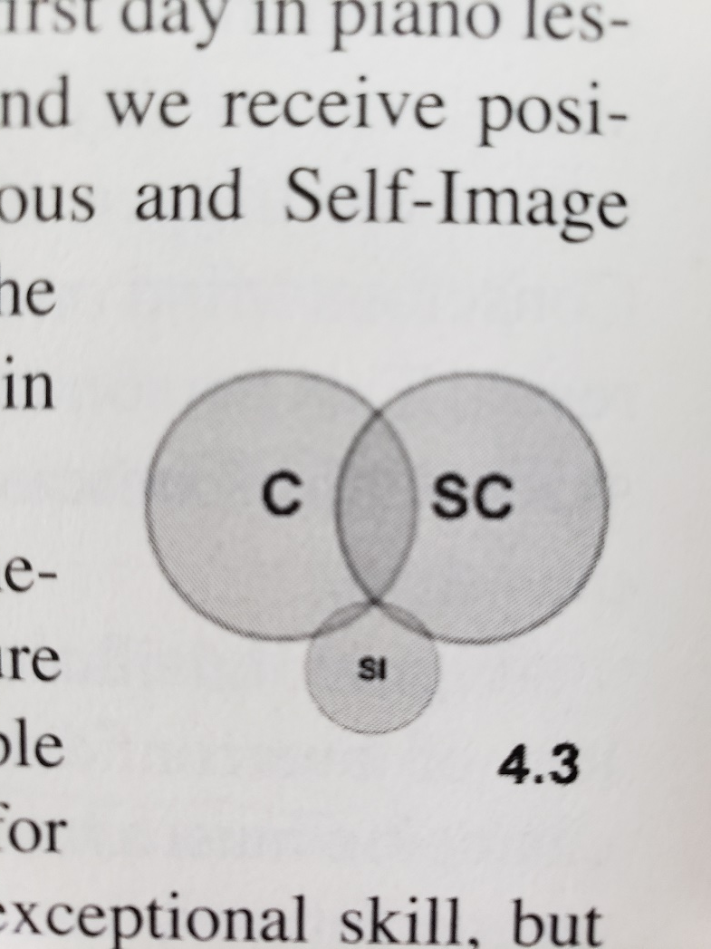
Self image has not kept pace
Somebody who scores well in practice, but not in competition
Does not quite believe in themselves yet
  Oftentimes they don’t work on this aspect!

Slide 16
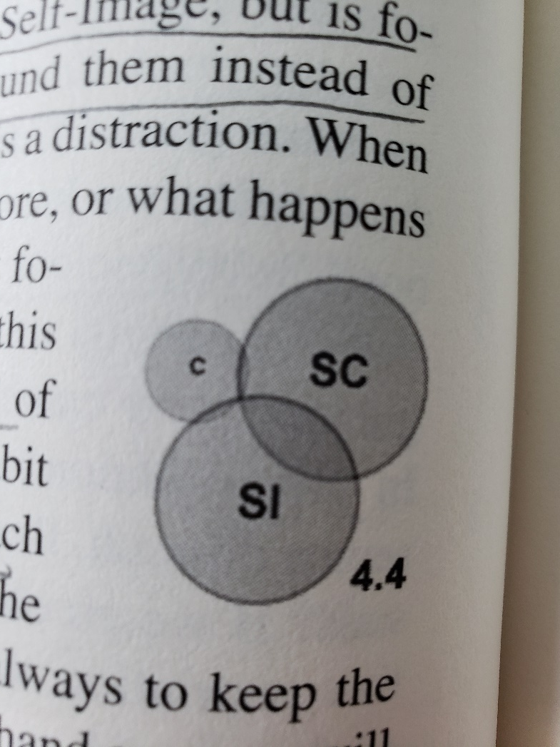
The environment takes precedence over process
Environment is a distraction
Don’t focus on execution
  “Gunslinger” mentality

Slide 17
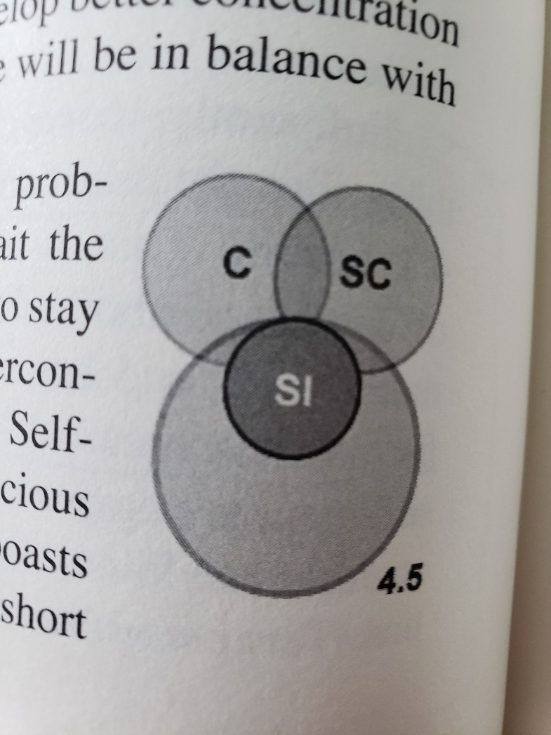
Overconfidence
Self image is oversized and subconscious skill does not keep pace
Imagined self image is larger than his actual one

Slide 18
We don’t want to spend a lot of time and energy and not progress…
Ask yourself:
  Am I out of balance?
  Am I concentrating on my goals?
  Do I really possess the skills to do my job well?
  Do I need more training?
  Is it like me to do the job, or do I need to change something about me to do the work?

